Slide 1
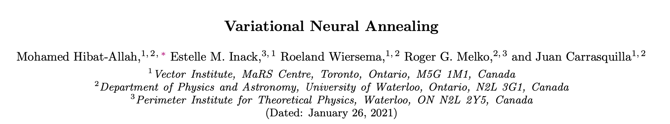
Variational Neural Annealing

Slide 2
Outline
SA vs Variational Classical Annealing
SQA vs Variational Quantum Annealing
Experiments and Results
Discussion

Slide 3
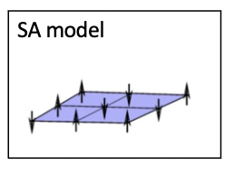
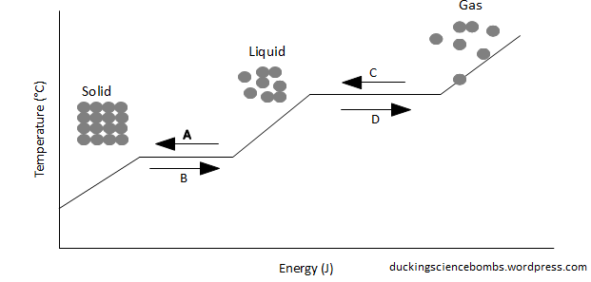
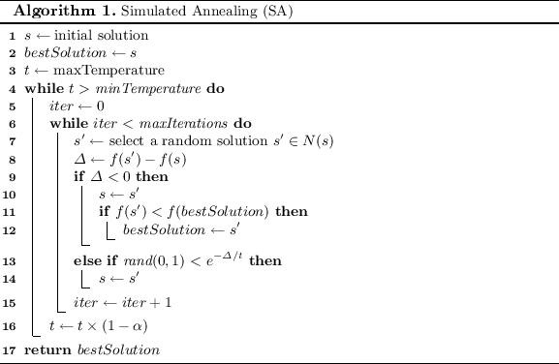
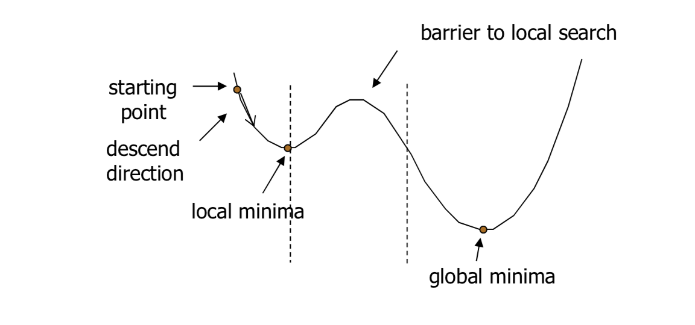
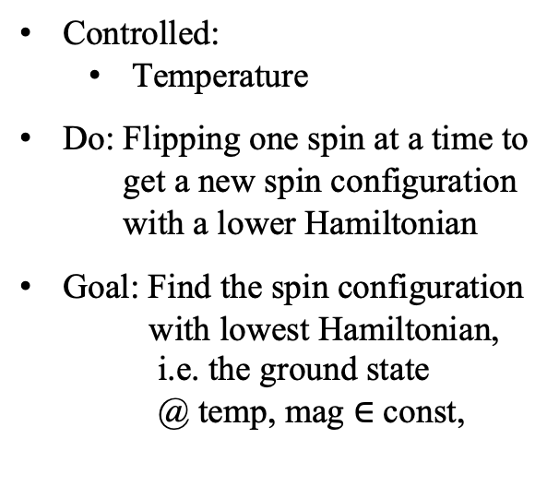
Simulated Annealing (SA)
Controlled:
Temperature
Do: Flipping one spin at a time to get a new spin configuration with a lower Hamiltonian
Goal: Find the spin configuration with lowest Hamiltonian, i.e. the ground state @ temp, mag $∈$ const,
Notes:
因為論文用到其中兩種方法，我們先簡述這兩種
SA，SA其實就是模仿鐵原子
為什麼要利用磁場：找到paramagnetic （順磁性）
為什麼要利用溫度：因為溫度是影響原子的能量最大的因素，溫度越大總動能越大，致使總能量越高

Slide 4
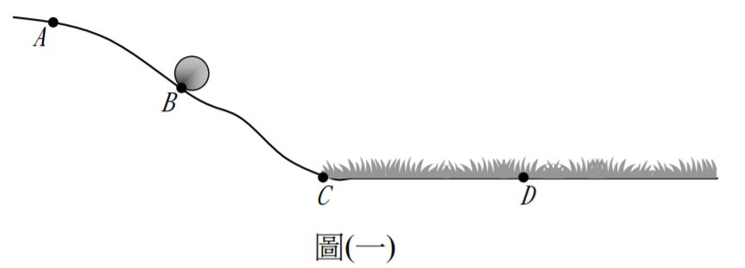
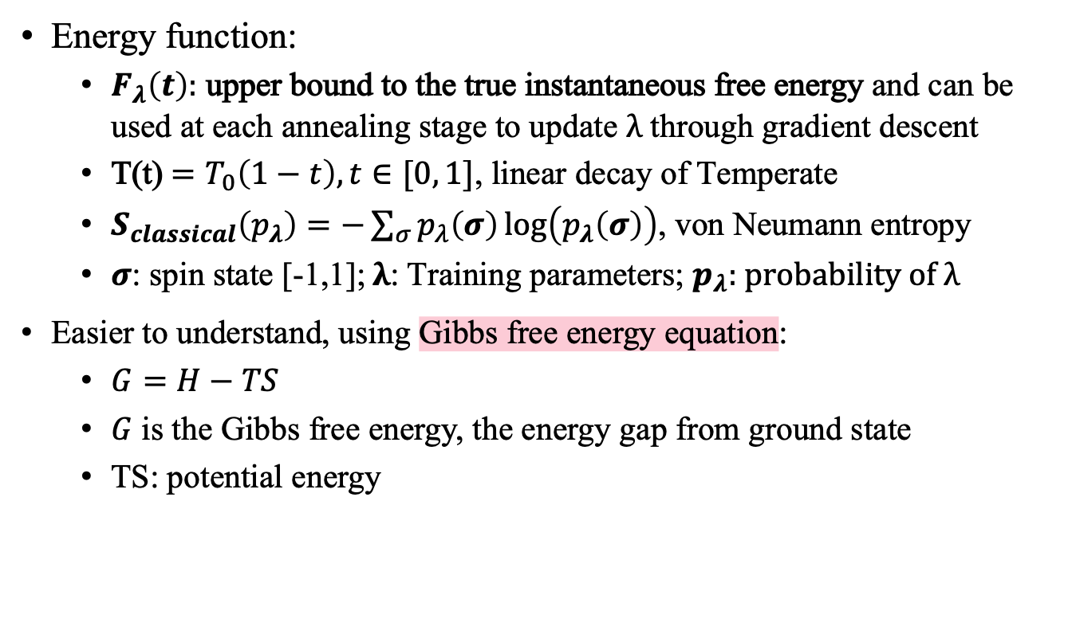
Variational Classical Annealing (VCA) protocol
Energy function:
$F_{λ}\left(t\right):$ upper bound to the true instantaneous free energy and can be used at each annealing stage to update λ through gradient descent
T(t) $=T_{0}\left(1−t\right), t∈[0, 1]$, linear decay of Temperate
$S_{classical}\left(p_{λ}\right)=−\sum_{σ}{p_{λ}\left(σ\right)\log\left(p_{λ}\left(σ\right)\right)}$, von Neumann entropy
$σ$: spin state [-1,1]; λ: Training parameters; $p_{λ}$: probability of λ
Easier to understand, using Gibbs free energy equation:
$G=H−TS$
$G$ is the Gibbs free energy, the energy gap from ground state
TS: potential energy
熵
Notes:
$G≠0$ implies that the spins under this configuration have residual energy to oscillate
$G=0$ implies that the spins under this configuration is ground state
首先是VCA (main focus)，比較他與SA
用圖片去簡述他們的演算法 (page.3以及Appendix. D)

Slide 5
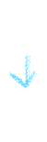
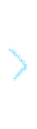
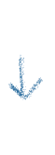
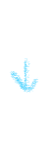
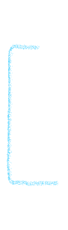
VCA annealing step’s Flowchart
can be used at each annealing stage to update λ
through gradient descent
Based on the λ, predict a
new set of spin configuration
Calculate the lower Hamiltonian by the new spin configuration
Routine the steps many times, to get a spin configuration
with the lowest Hamiltonian that we can find by the algorithm

Slide 6
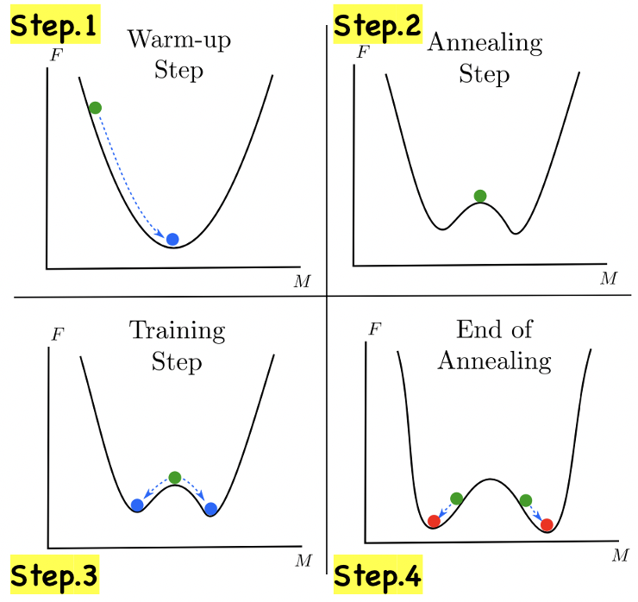
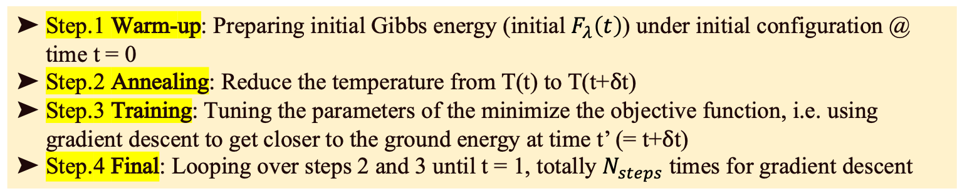
Step.1 -> (Step.2 -> Step.3)$N_{annealing}$ -> Step.4
Step.1 Warm-up: Preparing initial Gibbs energy (initial $F_{λ}\left(t\right)$) under initial configuration @ time t = 0
Step.2 Annealing: Reduce the temperature from T(t) to T(t+δt)
Step.3 Training: Tuning the parameters of the minimize the objective function, i.e. using gradient descent to get closer to the ground energy at time t’ (= t+δt)
Step.4 Final: Looping over steps 2 and 3 until t = 1, totally $N_{steps}$ times for gradient descent

Slide 7
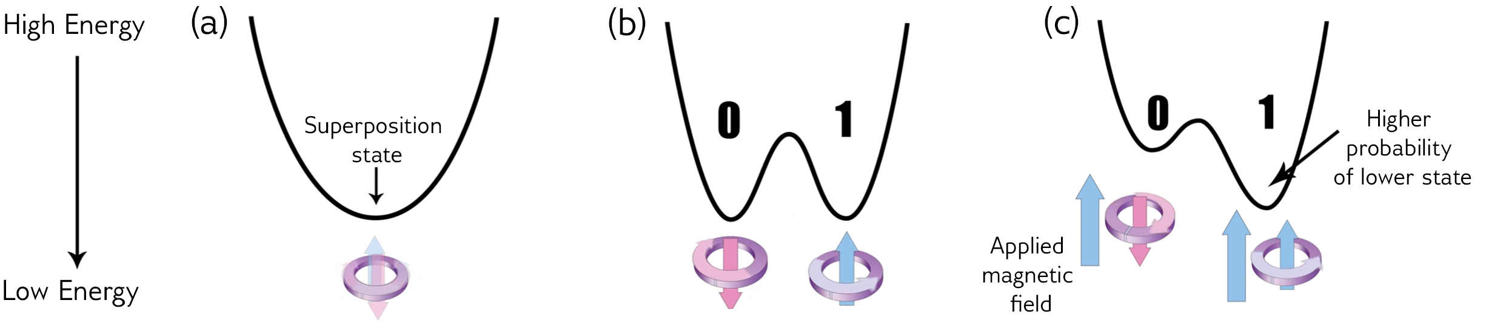
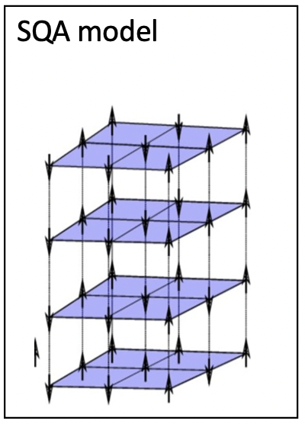
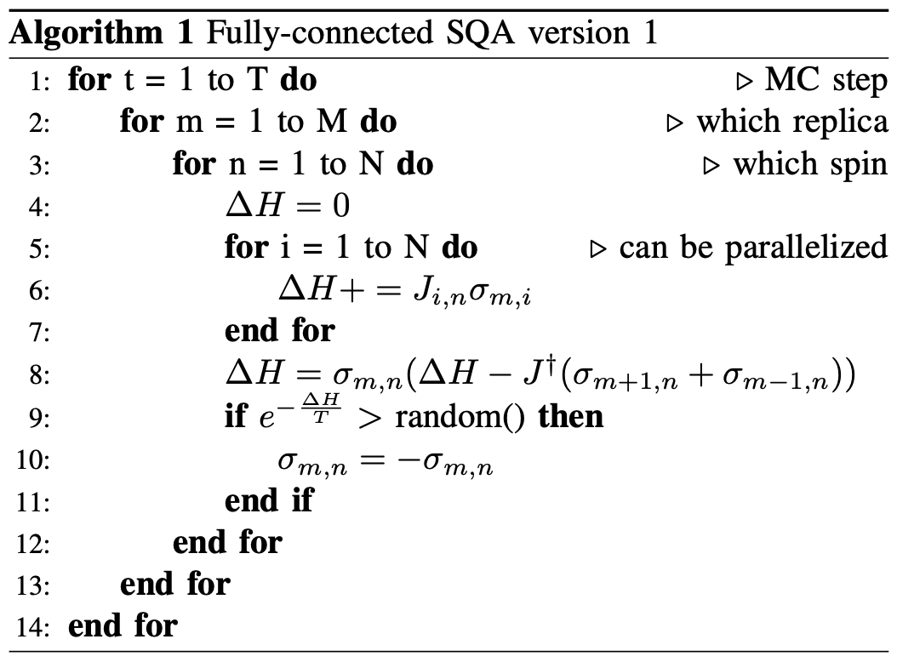
Simulated Quantum Annealing (SQA)
Quantum Annealing
Notes:
SQA
簡易的SQA，同上
用圖片、用能量、提到磁場
這部分有個很重要的是提到量子穿隧，如果可以要比較SA與SQA的不同。

Slide 8
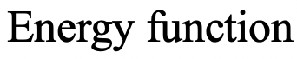
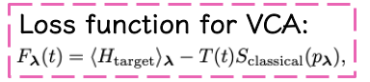
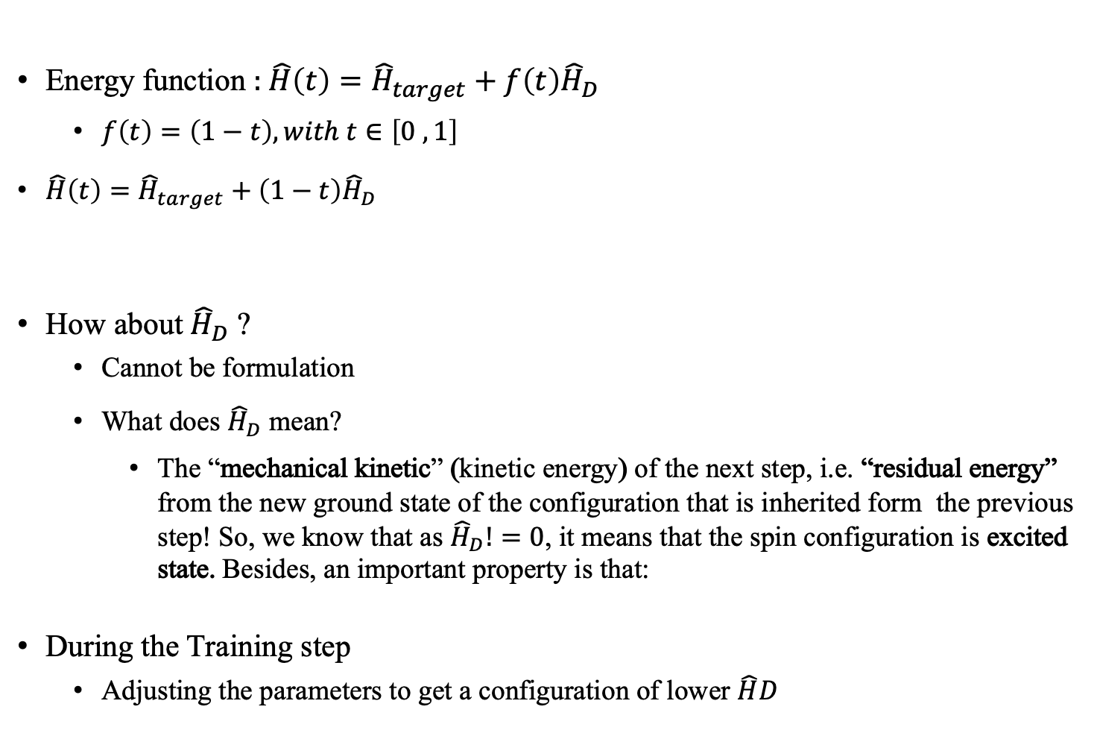
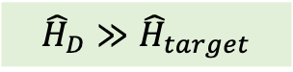
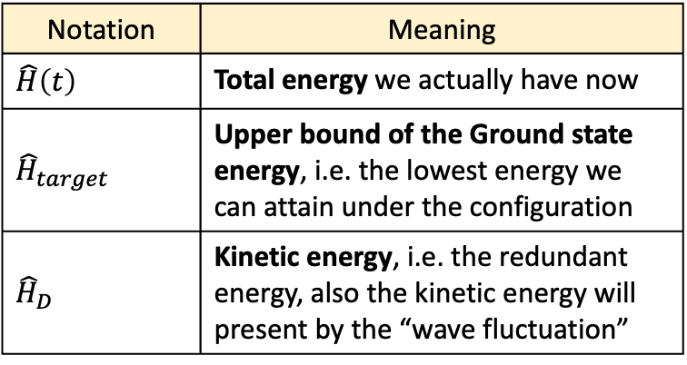
Variational Quantum Annealing (VQA) protocol
Energy function : $\hat{H}\left(t\right)={\hat{H}}_{target}+f\left(t\right){\hat{H}}_{D}$
$f\left(t\right)=\left(1−t\right), with t∈\left[0 ,1\right]$
$\hat{H}\left(t\right)={\hat{H}}_{target}+\left(1−t\right){\hat{H}}_{D}$
How about ${\hat{H}}_{D}$ ?
Cannot be formulation
What does ${\hat{H}}_{D}$ mean?
The “mechanical kinetic” (kinetic energy) of the next step, i.e. “residual energy” from the new ground state of the configuration that is inherited form the previous step! So, we know that as ${\hat{H}}_{D}!=0$, it means that the spin configuration is excited state. Besides, an important property is that:
During the Training step
Adjusting the parameters to get a configuration of lower $\hat{H}D$
Notation | Meaning
$$\hat{H}\left(t\right)$$ | Total energy we actually have now
$${\hat{H}}_{target}$$ | Upper bound of the Ground state energy, i.e. the lowest energy we can attain under the configuration
$${\hat{H}}_{D}$$ | Kinetic energy, i.e. the redundant energy, also the kinetic energy will present by the “wave fluctuation”
$${\hat{H}}_{D}≫{\hat{H}}_{target}$$
Notes:
ＨＤ是一開使給定的直，也就是我們一開始給定整個能量場的動能，此外該動能的大小會由磁場大小來決定。

Slide 9
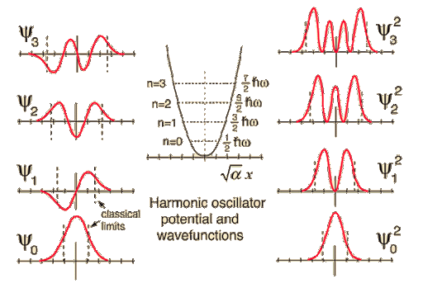
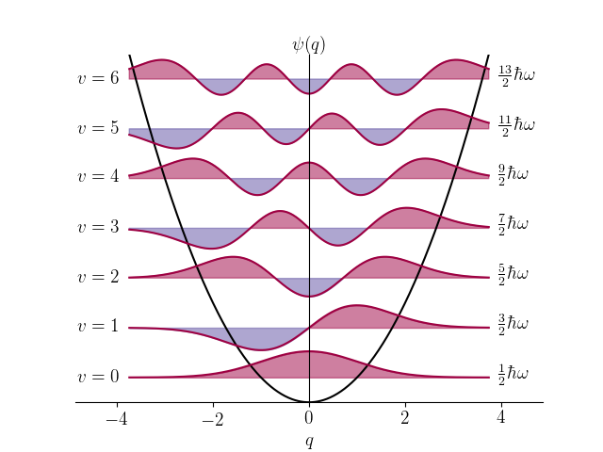
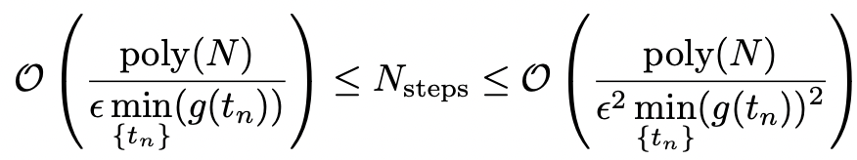
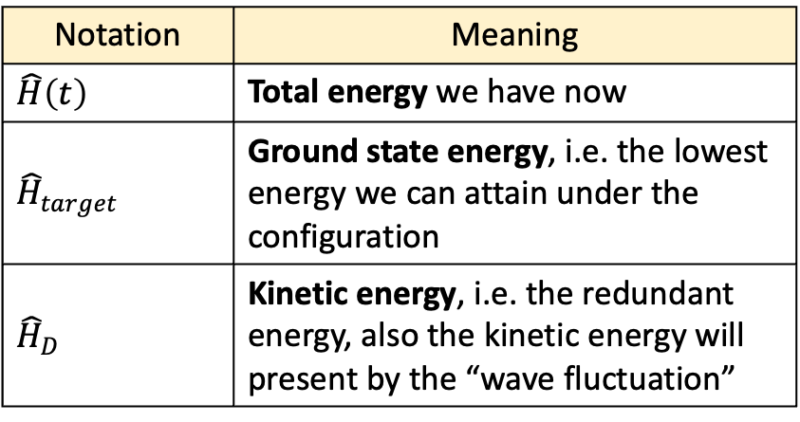
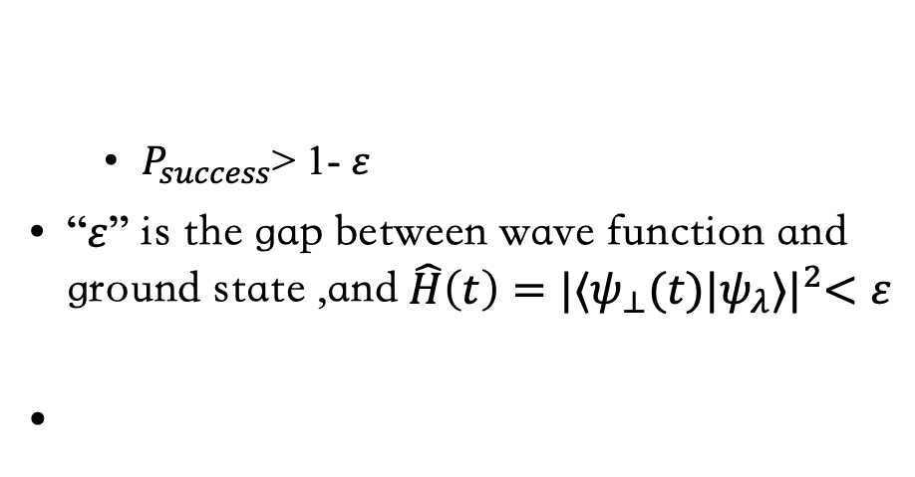
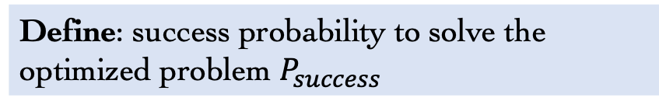
#Steps should run to converge (VQA)
Notation | Meaning
$$\hat{H}\left(t\right)$$ | Total energy we have now
$${\hat{H}}_{target}$$ | Ground state energy, i.e. the lowest energy we can attain under the configuration
$${\hat{H}}_{D}$$ | Kinetic energy, i.e. the redundant energy, also the kinetic energy will present by the “wave fluctuation”
Define: success probability to solve the optimized problem $P_{success}$
$P_{success}$> 1- $ε$
“$ε$” is the gap between wave function and ground state ,and$\hat{H}\left(t\right)=|{⟨ψ_{⊥}(t)|ψ_{λ}⟩|}^{2}<ε$
Define: success probability to solve the optimized problem $P_{success}$
NOTE: (1) $g(t)$ is the energy gap between the first excited state and the ground state of the instantaneous Hamiltonian $\hat{H}\left(t\right)$, (2) N is system size, (3) {$t_{n}$} is the set of times
Notes:
$\hat{H}\left(t\right)=|{⟨ψ_{⊥}(t)|ψ_{λ}⟩|}^{2}<ε$.會成立是因為：
此處的$\hat{H}\left(t\right)為grond$state 的能量，而$ε$ 為HD-H_ground，又HD >> H_ground
故上式成立。
此外一個相當重要的事情是什麼東西會影響excited state是利用磁場，因此在後面的幾個實驗中我們可以看到HD的形式都會與磁場有關
那po出這條柿子的意義是，我們可以知道Nstep是多項式收斂的，其中$ε$是Ｎ的多項次的inverse。
那關於這部分的數學推導，因為時間限制所以會放在最後一夜PPT
這裡要提到收斂的數學過程會被post在最後一夜PPT
數學過程放在PPT最後面

Slide 10
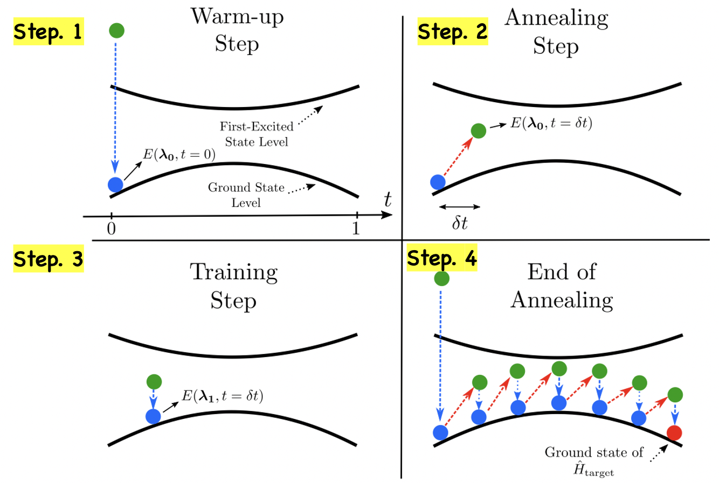
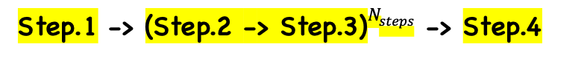
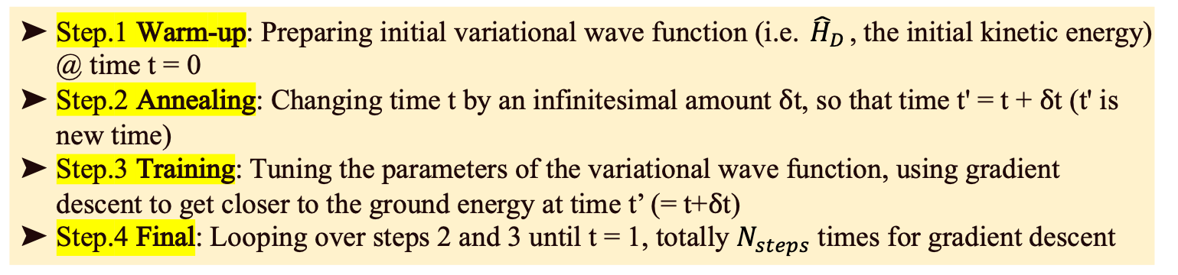
Step.1 -> (Step.2 -> Step.3)$N_{steps}$ -> Step.4
Step.1 Warm-up: Preparing initial variational wave function (i.e. ${\hat{H}}_{D}$, the initial kinetic energy) @ time t = 0
Step.2 Annealing: Changing time t by an infinitesimal amount δt, so that time t' = t + δt (t' is new time)
Step.3 Training: Tuning the parameters of the variational wave function, using gradient descent to get closer to the ground energy at time t’ (= t+δt)
Step.4 Final: Looping over steps 2 and 3 until t = 1, totally $N_{steps}$ times for gradient descent
Notes:
Take an Graphic example to understand
但我們在看這一步驟的時候會發現，2~3步驟當然是越多步驟越好，因此我們需要找出最少需要幾步可以達到ground state收斂

Slide 11
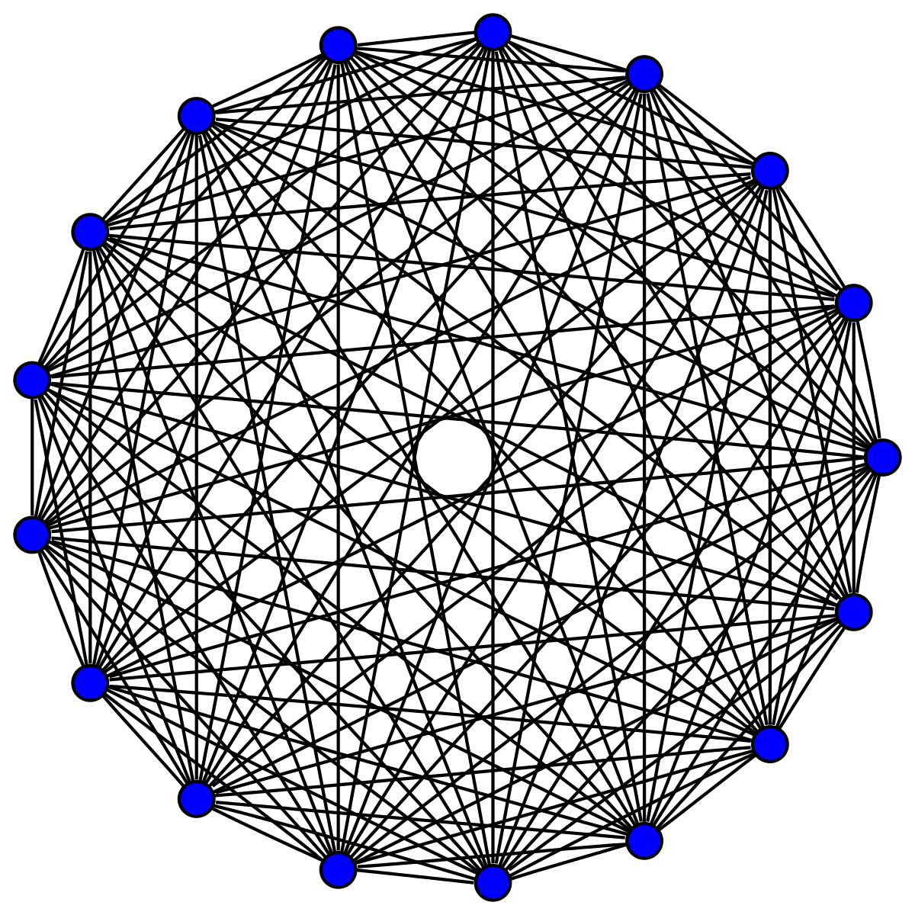
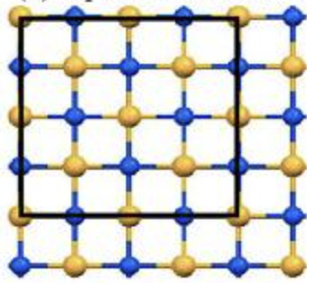
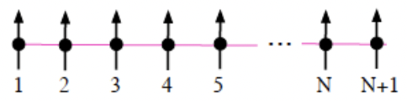
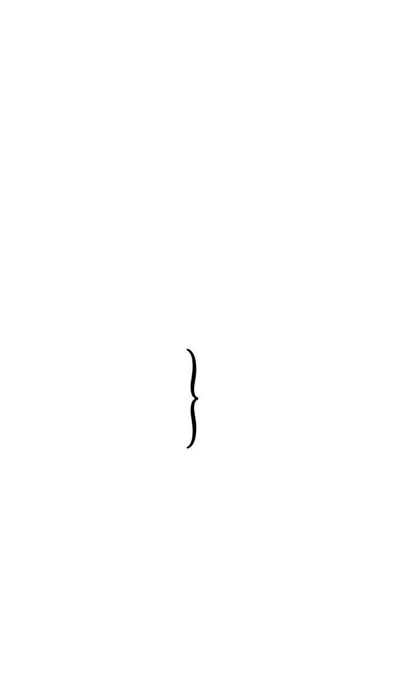
Experiment Settings
Three progressively experiments to demonstrate the the performance of VCA and VQA protocols
Exp1. Annealing on random Ising chains
Exp2. Edwards Anderson model
Exp3. Fully-connected spin glasses models
By connectivity
Notes:
第一個：chain，只和下一個spin相連
第二個：模擬分子的簡單立方model，每個spin會和相近的spins相連
第三個：fully connected，全連結，所有人都相連
我們可以看到實驗排序就是連結度的上升，那為什麼連結度越高會難做的原因是因為限制會越多，牽一髮而動全身，導致spin flipping越難，也就讓能量下降回到Ground state變成很難的事情。
另外在computational space的難題是平行度很低。
總共有三個實驗，是根據連結度 (問題難度) 節節攀升，首先會是chain,一直到全連結，全連結的問題最難是因為你要考慮的東西越多，要不要翻會更不容易，且一般來說在做全連結的時候，平行度會很低，因此全連結在量子模擬上要做到非常快是很困難的問題。

Slide 12
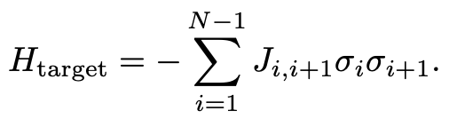
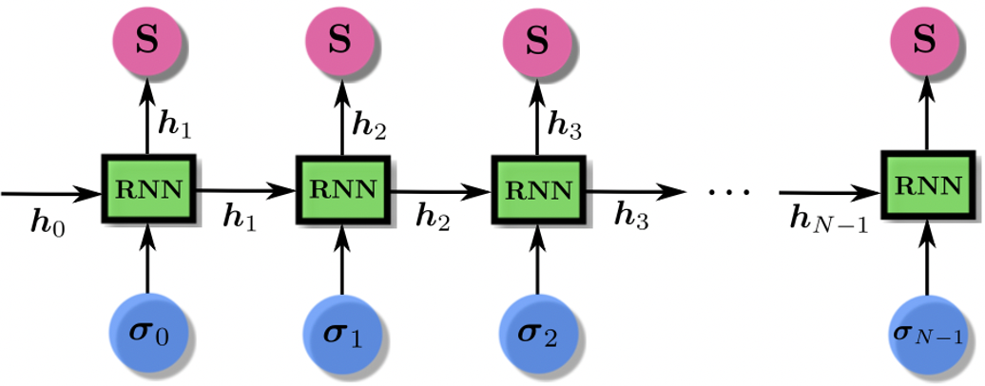
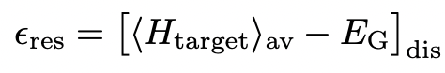
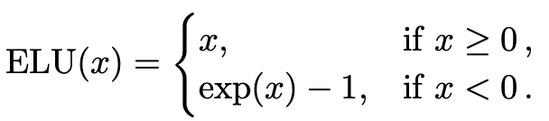
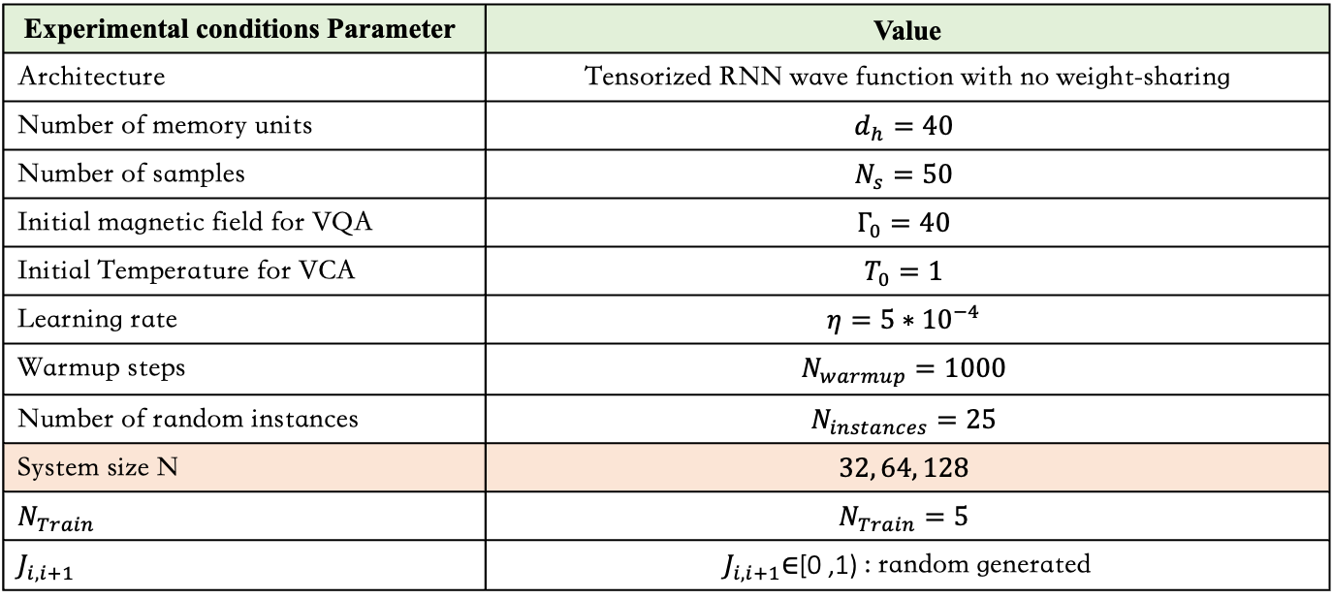
Experiment -1. Annealing on random Ising chains
Target Hamiltonian:
Loss function:
Activation function:
Experimental conditions Parameter | Value
Architecture | Tensorized RNN wave function with no weight-sharing
Number of memory units | $$d_{h}=40$$
Number of samples | $$N_{s}=50$$
Initial magnetic field for VQA | $$Γ_{0}=40$$
Initial Temperature for VCA | $$T_{0}=1$$
Learning rate | $$η=5∗{10}^{−4}$$
Warmup steps | $$N_{warmup}=1000$$
Number of random instances | $$N_{instances}=25$$
System size N | $$32, 64, 128$$
$$N_{Train}$$ | $$N_{Train}=5$$
$$J_{i,i+1}$$ | $J_{i,i+1}$∈[0 ,1) : random generated
Notes:
Experimental conditions
System size N 其實就是#spins = 32, 64, 128
$N_{Train}$ = 5 會設定為五次是因為他們發現五次就足夠收斂了
$J_{i,i+1}$: random generated 連結的權重是random generated

Slide 13
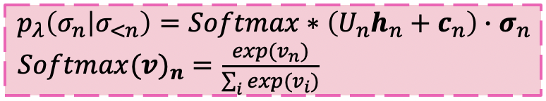
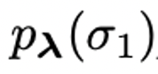
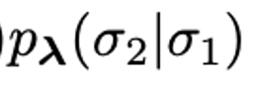
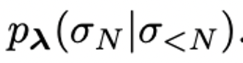
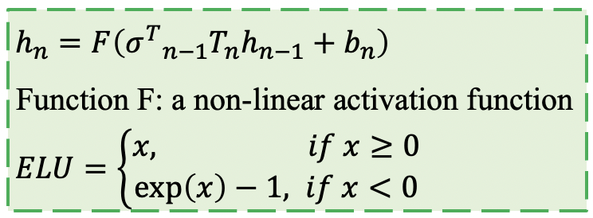
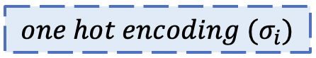
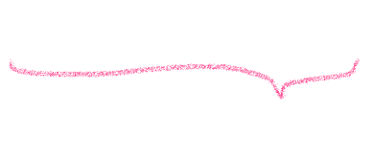
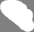
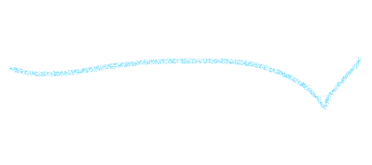

1D Tensorized RNN
[0.3, 0.7]
[0.4, 0.6]
= [0.3, 0.7]
Spin = [ -1, 1]

Slide 14


Graphic RNN

Slide 15

Experiment Results -1

Slide 16


Experiment -2. Edwards Anderson model
Target Hamiltonian:
Loss function:
Activation function:
Experimental conditions Parameter | Value
Architecture | 2D Tensorized RNN wave function with no weight-sharing
Number of memory units | $$d_{h}=40$$
Number of samples | $$N_{s}=25$$
Initial magnetic field for VQA | $Γ_{0}=1$ (for SQA,VQA and RVQA)
Initial Temperature for VCA | $T_{0}=1$ (for SA, VCA and RVQA)
Learning rate | $$η={10}^{−4}$$
Warmup steps | $N_{warmup}=1000$ for 10x10 | $N_{warmup}=2000$ for 40x40
Number of random instances | $$N_{instances}=25$$
System size N | 10x10, 40x40
Number of Trotters | P = 20
$$J_{i,i+1}$$ | $J_{i,i+1}$∈[0 ,1) : random generated
Notes:
Experimental conditions
System size N 其實就是#spins = 32, 64, 128
$N_{Train}$ = 5 會設定為五次是因為他們發現五次就足夠收斂了
$J_{i,i+1}$: random generated 連結的權重是random generated

Slide 17




2D Tensorized RNN
2D Tensorized: Zigzag path
Different from 1D Tensorized RNN:
$T_{i,j}$ are site dependent weight tensors that have dimension $4∗2d_{h}∗d_{h}$

Slide 18


Experiment Results -2
System size N
10x10 (spins) | 40x40 (spins)

Slide 19


Experiment -3-1. Fully-connected spin glasses models
Model: Sherrington-Kirkpatrick (SK) model
Target Hamiltonian
Activation function:
Experimental conditions Parameter | Value
Architecture | Dilated RNN wave function with no weight-sharing
Dilated Tensorized RNN | $$\left\lceil \log_{2}\left(N\right)\right\rceil =7$$
Number of memory units | $d_{h}=40$ (= $h_{n},$ hidden units at this experiment)
Number of samples | $$N_{s}=50$$
Initial magnetic field for VQA | $Γ_{0}=2$ (for SQA)
Initial Temperature for VCA | $T_{0}=1$ (for SA and VCA)
Learning rate | $$η={10}^{−4}$$
Warmup steps | $$N_{warmup}=2000$$
Number of random instances | $$N_{instances}=25$$
System size N | 100 spins
Number of Trotters | P = 100
Output | Average of ${10}^{6}$ outcomes
Notes:
LOSS function: Residual energy

Slide 20



Experiment -3-2. Fully-connected spin glasses models
Model: Wishart planted ensemble (WPE) model
Target Hamiltonian:
Activation function:
Experimental conditions Parameter | Value
Architecture | Dilated RNN wave function with no weight-sharing
Dilated Tensorized RNN | $$\left\lceil \log_{2}\left(N\right)\right\rceil =5$$
Number of memory units | $d_{h}=20$ (= $h_{n},$ hidden units at this experiment)
Number of samples | $$N_{s}=50$$
Initial magnetic field for VQA | $Γ_{0}=1$ (for SQA)
Initial Temperature for VCA | $T_{0}=1$ (for SA and VCA)
Learning rate | $$η={10}^{−4}$$
Warmup steps | $$N_{warmup}=1000$$
Number of random instances | $$N_{instances}=25$$
$α$ of Couplings matrix $J_{i,i+1}$ | {0.25, 0.50}
System size N | 32 spins
Number of Trotters | P = 100
Notes:
LOSS function: Residual energy

Slide 21





Dilated RNN
Problem: Gradient vanishing problem
Alleviate method: use “Dilated RNNs”, which are multi-layered RNNs that use dilated connections between spins to model long-term dependencies

Slide 22


Experiment Results -3
SK model | WPE model exp1 | WPE exp2
- | $α$ (para of J matrix) = 0.25 | $α$ (para of J matrix)= 0.50
100 spins | 32 spins | 32 spins
Notes:
8. 在SK model他說，VCA只是需要跑多一點的steps，但同理我們不能確定說SA SQA是不是收斂了，說不定再跑一些step， SA SQA的能量又會下去了。你只能說喔在那個#steps 下VCA的確是最好的，但在其他的steps下我們就不能保證這個結果。但在論文中，他們有提到他們去跑了200次的SQA在直線圖中結果也是一樣。我去觀察了原因是因為2002年的SQA他們的initialize的random number都是一樣的，換言之，跑幾次根本不會有差別。

Slide 23


Discussion for cons for VNN
Why VCA get better performance than SA, SQA?
Key: the SA, SQA they used are 2002 version
Solving problems properties
MAX-CUT problem: Gset
Cost time, normally SQA training time:
32768 spins, 4 trotters 256 (ms) on FPGA (Tohoku, 2020)
Training models are problem dependent
All the $Γ_{0}$ they choose for SQA are too small
Arcane rule: “Stop steps” are cooperated to VCA
Notes:
先解不好的，我希望可以壓在2頁
1. 他挑選的問題基本上並不適合SQA解決，SQA適合解決的問題(放上那張圖)，有小的大跳躍的狀態才適合。應該去跑一些像是MAX-CUT (Gset benchmark), 等常用的benchmarks。
3. 另外最大的點是training的時間，一般simulation都很快，像是在府機組FPGA上只要幾毫秒，但這個並沒有顯示時間。他們並沒有把training model的時間算進去，且基本上對於一個新的問題，他們就要重train一次model。
4. 重點的重點，他們比較的SA和SQA適合2002年的論文比較＝＝
5.另外是，在SK model實驗中，他給SQA的磁場大小也選得不對。
6. 他們停止的steps是讓VCA能量下去，但其實從最後一個實驗看起來就可以知道，SA SQA都有機會下去，再多跑幾個steps之後
最後是很怪異的點，是他們定義SK model的最低能量是用VCA找到的最低能量，然而，在2006年spins number 小魚100的SK model的的ground state 漢米爾頓都已經被找到了。

Slide 24
Discussion for pros for VNN
Meaning of the Research:
Simulation for annealing or quantum annealing
Like SA, SQA, SB, SCA, etc.
Main focus on “ms / Monte Carlo steps”
Acceleration Based
Seems prodigal use of time
Performance for the solution quality
That is, the lowest Hamiltonian that the protocols can achieve
Precursors of the Research field
More attractive: Reinforce Learning
Notes:
最後還是要講一下，這個研究方向的意義
一般來說，模擬的研究可以分成兩個部分，一方面就是速度快，另一方面是準度
在速度的方面，一般做量子模擬我們使用FPGA、另外富士通也做出了專門解決該問題的晶片叫做DAU他在物理系有token可以使用，或者是GPU因為GPU平行度高。
那這篇論文很明顯在這速度方面不佔優勢，相反，目前使用機器學習做量子模擬專注的點是他的能量可以達到越低的地方，也就是我忘了那個名詞叫啥準確率之類的感覺就不是，
其實也就是這篇論文的重點，他可以達到更低的能量狀態，另外在實驗結果也可以看到他更好的跳脫出local minimum。反正他就是著重在Performance
We have used a simple annealing schedule in our protocols and highlight that reinforcement learning can be used to improve it.
可以加入reinforcement learning

Slide 25
End

Slide 26
Supplement Facts

Slide 27



VCA converge

Slide 28




VQA and SGD convergence
Notes:
再者是A ，比較他與SQA
用圖片去簡述他們的演算法 (page.3以及Appendix.D)
這裡要提到residual energy ，不同於利用加速器做模擬直接讓 Hamiltonian 最小，這邊使用的是讓residual energy 最小，放出公式他就是所謂的Gibbs free energy
利用拉升 t+deltat使得穩態變成激發態度，如此一直下去。

Slide 29


Cont’d

Slide 30



備用
$$p_{λ}\left(σ_{n} | σ_{<n}\right)=Softmax\left(U_{n}h_{n}^{\left(L\right)}+c_{n}\right)∙σ_{n}$$
$$Softmax(v)_{n}=\frac{exp⁡(v_{n})}{\sum_{i}{exp⁡(v_{i})}}$$
$${h_{n}}^{(l)}=F\left({W_{n}}^{(l)}[h_{\max\left(0, n−2^{l−1}\right)}^{\left(l\right)}; h_{n}^{(l−1)}]+b_{n}^{(l)}\right)$$
Function F: a non-linear activation function
$ELU=\left\{\begin{aligned} x, if x ≥0 \\ \exp\left(x\right)−1, ifx<0\end{aligned}\right.$

